Slide 1


CLINICAL TRIAL

Slide 2
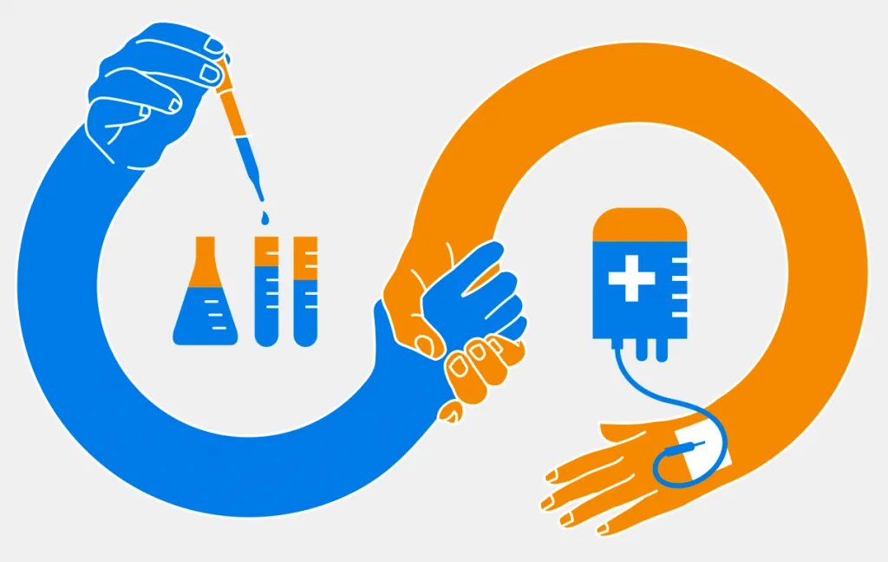

Slide 3
CLINICAL TRIAL​

Slide 4
<CLINICAL TRIAL>
A clinical trial is a research study that tests new treatments (medicines, vaccines, therapies) on people.
It helps scientists see if a treatment is safe and effective before it becomes widely available.

Slide 5
<CLINICAL TRIAL>
Clinical trials help us:
Find new ways to treat diseases
Improve current treatments
Discover cures for serious illnesses
Ensure drugs are safe for everyone.

Slide 6
<CLINICAL TRIAL>
Clinical trials happen in 3 big steps:
Idea & Research – Scientists develop a new treatment.
Lab Testing – The treatment is tested on cells or animals.
Human Testing – If it looks promising, it moves to human trials!

Slide 7
<CLINICAL TRIAL>
PHASES OF CLINICAL TRAILS:
Phase 1 – Small group (20-100 people) → Check safety & side effects.
Phase 2 – Larger group (100-500 people) → See if the treatment works.
Phase 3 – Thousands of people → Compare with existing treatments.
Phase 4 – Approved and monitored in the public.

Slide 8
<CLINICAL TRIAL>
WHO CAN JOIN CLINICAL TRAIL?
Each trial has specific criteria (age, medical history, condition).
People join to get early access to new treatments and help advance medicine.

Slide 9
<CLINICAL TRIAL>
Benefits:
Access to new treatments before they are widely available.
Free medical care during the trial.
Helping future patients by advancing medicine.

Slide 10
<CLINICAL TRIAL>
Risks:
Possible side effects.
Treatment may not work.
Requires frequent checkups and monitoring.

Slide 11
<CLINICAL TRIAL>
COVID-19 vaccines went through fast-track clinical trials with thousands of volunteers.
Scientists studied their effects carefully before public distribution.
This is proof that clinical trials save lives! Without them, we wouldn’t have quick, safe responses to global health emergencies.

Slide 12
<FUN FACT>
Take a guess!
Which famous soft drink was originally developed as part of a clinical trial for nerve disorders? 🤔🥤
(A) Coca-Cola (B) Pepsi (C) Dr Pepper (D) 7UP

Slide 13
7UP was first called "Bib-Label Lithiated Lemon-Lime Soda" in 1929 🥤.
It contained lithium, a drug used to treat mood disorders like bipolar disorder and depression💊.
Lithium was removed in 1948, but the drink remained popular!

Slide 14


Thank You

